Slide 1
Introduction to SQL
IST 659 – Lecture 6

Slide 2
Today’s Goal
Concept
SQL schema
The sequence of generating multiple tables
Skills
Create tables
Drop tables
Insert values
Delete values
Change table schema

Slide 3
SQL (Structured Query Language)
Why SQL?
A common language shared by all DBMS software
The query is written by specifying the form of the results declaratively. You do not need to worry about how it is performed.
Flexible …

Slide 4
SQL Environment
Schema
The structure that contains descriptions of objects created by a user (base tables, views, constraints)
Data Definition Language (DDL)
Create table, alter table, drop table
Create indices, views
Establish constraints like foreign keys
Data Manipulation Language (DML)
Insert
Delete
Update
Select (search)
Data Control Language (DCL)
Add or delete users
Grant and revoke privileges to access database

Slide 5
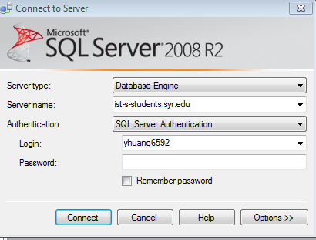
Let’s start with SQL Server…
Server name: ist-s-students.syr.edu
Connecting using a lab machine
https://answers.syr.edu/display/ischool/Connecting+to+Microsoft+SQL+Server+-+ON+domain
Connecting the server from your personal computer
https://answers.syr.edu/display/ischool/Connecting+to+Microsoft+SQL+Server+-+OFF+domain

Slide 6
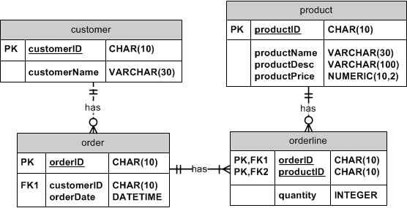
How would you generate tables for this ER diagram?
Step 1: determine the sequence of creating the tables.
Step 2: creating individual tables and connecting them if necessary.

Slide 7
Step 1: The Order of Creating Tables
Referential integrity check
Create entities without FKs first
E.g. Customer and Product tables
They don’t have foreign keys
Then create entities with FKs
Order and then Orderline
Any table that has foreign key referenced to another table cannot be created until the other table has been created

Slide 8

Step 2: When Creating One Table
Define Table name
Identify data types for attributes
Identify columns that can and cannot be null
Identify columns that must be unique (candidate keys)
Identify primary key–foreign key mates
Determine default values
Identify constraints on columns (domain specifications)
Create the table and associated indexes

Slide 9



Starting with strong tables - CREATE
Try to explain this script
Attention please:
Now drop the table
an alternative way to define the Primary Key.
No comma at the last line.
For good coding style, capitalize keywords.
If a field is required, add “NOT NULL” constraint.
Semi-colon in the end
using CONSTRAINT
Make sure you still specify the PK field to be NOT NULL.
A good naming convention, tableName_PK for the PK constraint.
In fact, if you have a composite key, this is the ONLY right way to define the PK.

Slide 10

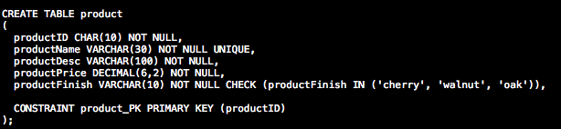
UNIQUE and CHECK constraints
UNIQUE makes sure the productName does not duplicate
CHECK makes sure when inserting a new record, the value for that field has to be one of the values IN the set.

Slide 11

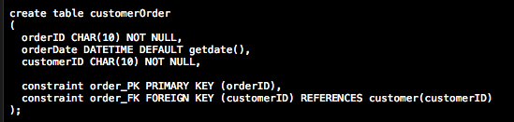
Foreign Keys & Default Value
getdate() is a system-defined function, which is called, whenever you insert a new record.
A good naming convention, tablename_FK for the FK constraint.
REFERENCES specify the parent table and its PK of the FK.

Slide 12

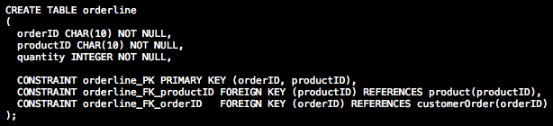
Multiple FKs and Composite PK
Again, when it’s a composite PK, you have to define the constraint in this format explicitly
When you have multiple FKs, for good naming conventions, you want to define the constraint as tableName_FK_columnName.

Slide 13
Sequence of Populating the Tables
After creating the tables, you may insert records
the sequence of inserting records is the same as creating the tables.
Strong tables first
Weak tables second

Slide 14
Populating tables - INSERT
Two ways to insert records:
Do not specify the column names, then you need to follow the sequence of your column definitions.
2. Specify the sequence of the columns, then you can skip some optional columns.

Slide 15
Review the records - SELECT
Check the current records in one table by SELECT all the fields.
Star * means all the fields will be returned
You can also select some fields
DELETE FROM the table will remove all the records.

Slide 16
CHECK constraint violation
Insert more to another strong table, i.e. product table
Test the CHECK constraint
Fix the CHECK value
ash is not part of the constraint value set ('cherry', 'walnut', 'oak’), thus there will be an error message

Slide 17
Populate Weak Tables – inserting record with FK values
customerID must exist in the customer Table
orderDate will be today’s date, even though you didn’t specify it
You can also explicitly enter the date.
integrity constraint violation, Foreign key value doesn’t exist in the PK.

Slide 18
Sequence of Deleting Records
After inserting insert records, you may want to delete some records
the sequence of deleting records is opposite to inserting records.
Weak tables first
Strong tables second
Delete certain records

Slide 19

Updating records
As long as the update doesn’t break the FK constraint.
UPDATE a record

Slide 20

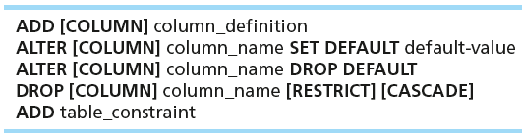

ALTER TABLE schema
ALTER TABLE statement allows you to change column specifications:
This adds a new column.

Slide 21
Exercises
Insert more records to the newly updated customer table
Insert one order of the customer
Then delete this new order.

Slide 22
Review Today’s Goal
Concept
SQL schema
The sequence of generating multiple tables
Skills
Create tables
Drop tables
Insert values
Delete values
Change table schema

Slide 23
Class exercise : Submit your script to Discussion Forum
Create tables in appropriate order
Correctly define the keys
Insert one record for each table

Slide 24
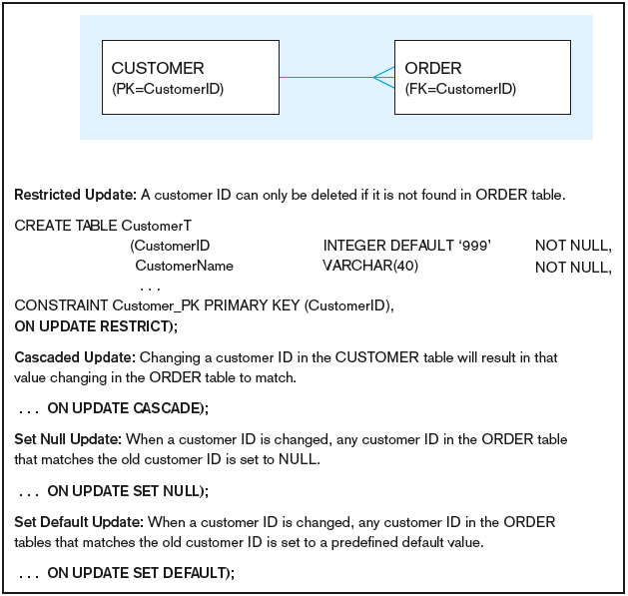
Figure 6-7 Ensuring data integrity through updates
Relational integrity is enforced via the primary-key to foreign-key match
Chapter 6
© 2013 Pearson Education, Inc. Publishing as Prentice Hall
24

Slide 25
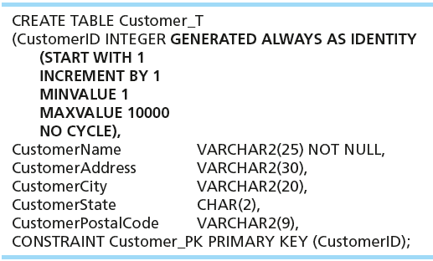
Create table with identity columns
Introduced with SQL:2008
Inserting into a table does not require explicit customer ID entry or field list
INSERT INTO CUSTOMER_T VALUES ( ‘Contemporary Casuals’, ‘1355 S. Himes Blvd.’, ‘Gainesville’, ‘FL’, 32601);

Slide 26
Table Index
Control processing/storage efficiency:
Choice of indexes
File organizations for base tables
File organizations for indexes
Data clustering
Statistics maintenance
Creating indexes
Speed up random/sequential access to base table data
Example
CREATE INDEX NAME_IDX ON CUSTOMER_T(CUSTOMERNAME)
This makes an index for the CUSTOMERNAME field of the CUSTOMER_T table

Slide 27
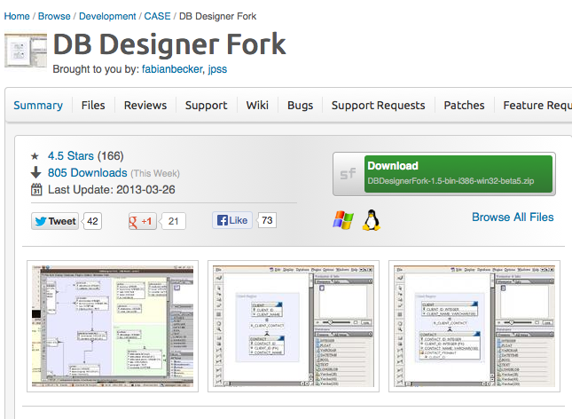
Additional Information : DB Designer Fork
http://sourceforge.net/projects/dbdesigner-fork/
Generate SQL scripts from your ER diagram

